Slide 1
1
Analysis of Algorithms
Notes:
Production Notes: Cheryl off screen and will speak to introduce the module.

Slide 2


2
Algorithm Efficiency and Big-O
Notes:
In this class we learn to solve problems with data structures and algorithms.
The data structures we study all involve a collection of objects.
Big-O notation expresses the performance of an algorithm as a function of the number of items in the collection to be processed

Slide 3
2
Algorithm Efficiency and Big-O
What do we analyze?
Running time
Number of operations
Worst case
Guarantee performance is better than this
O() is upper bound
Average case
Usual performance
Best case
Notes:
In this class we learn to solve problems with data structures and algorithms.
The data structures we study all involve a collection of objects.
Big-O notation expresses the performance of an algorithm as a function of the number of items in the collection to be processed

Slide 4
2
Algorithm Efficiency and Big-O
How do we count?
loops – count the running time of the statements in the loop and multiply by the number of iterations
Notes:
In this class we learn to solve problems with data structures and algorithms.
The data structures we study all involve a collection of objects.
Big-O notation expresses the performance of an algorithm as a function of the number of items in the collection to be processed

Slide 5
3
Linear Growth Rate
If processing time increases in proportion to the number of inputs n, the algorithm grows at a linear rate
int sum (int n)
{
int partialSum = 0;
for (int i=1; i<=n; i++)
partialSum += i;
return partialSum;
}
Notes:
Production Notes: Cheryl off screen and will use pointer to illustrate.
Cheryl Notes:
If the target is not present, the for loop will execute x.length times
If the target is present the for loop will execute (on average) (x.length + 1)/2 times
Therefore, the total execution time is directly proportional to x.length
This is described as a growth rate of order n OR
O(n) write O(n)
Point out graph of x.length vs time

Slide 6
2
Algorithm Efficiency and Big-O
How do we count?
Nested loops – count the running time of the statements in the loops and multiply by the product of the size of each loop
Notes:
In this class we learn to solve problems with data structures and algorithms.
The data structures we study all involve a collection of objects.
Big-O notation expresses the performance of an algorithm as a function of the number of items in the collection to be processed

Slide 7
4
Quadratic Growth Rate
If processing time is proportional to the square of the number of inputs n, the algorithm grows at a quadratic rate
public bool areUnique(int x[], int size) {
for(int i=0; i < size; i++) {
for(int j=0; j < size; j++) {
if (i != j && x[i] == x[j])
return false;
}
}
return true;
}
Notes:
The for loop with i as index will execute x.length times
The for loop with j as index will execute x.length times
The total number of times the inner loop will execute is (x.length)²
The growth rate has an order of n² or
O(n²) – Write O(n²)
Note the two loops – that’s your hint that this is quadratic
Point out the graph
The O() in the previous examples can be thought of as an abbreviation of "order of magnitude"
look at the loops and to see whether the loops are nested
Assuming a loop body consists only of simple statements,
a single loop is O(n)
a pair of nested loops is O(n²)

Slide 8
Logarithmic Growth Rate
int myNumber = 1;
for(i=1; i <= n; i *= 2) {
myNumber = myNumber*i;
}
Notes:
Cheryl Notes:
How many times does this loop execute?
The loop body will execute k times, with i having the following values: 1, 2, 4, 8, 16, . . ., 2^{k-1}
We know that 2^{k-1} <= x.length < 2^{k}
We know that log(2^{k}) = k
So the number of times that the loop executes is proportional to log(x.length)
This is O(log n). (Write this on the slide.)
In computer science we take logarithms in base 2. Because machine language is based on binary digits
Think of log base 2 as the number of times that you can divide a number by 2 before the value is less than 1.
When determining the computational complexity of code, if you see items being multiplied or divided, start thinking about whether it’s logarithmic

Slide 9
10
Formal Definition of Big-O
In terms of T(n),
T(n) = O(f(n))
If there exist
two constants, n₀ and c, greater than zero, and
a function, f(n),
such that for all n > n₀, cf(n) ≥ T(n)
In other words, as n gets sufficiently large (larger than n₀), there is some constant c for which the processing time will always be less than or equal to cf(n)
cf(n) is an upper bound on performance
Notes:
Here is the formal definition of Big-O.
We define a function T(n) as being “Big-O of” or “on the order of” f(n) if there exist two constants, no and c, such that for all n>no, c times f(n) is greater than T(n)
As n gets sufficiently large, we can find a constant such that c times f(n) is an upper bound on performance.
Saying T(n) is big-O of f(n) or on the order of f(n) means that f(n) is an upper bound on the performance of T(n)

Slide 10
9
Formal Definition of Big-O
Consider the following program structure:
for (int i = 0; i < n; i++) {
for (int j = 0; j < n; j++) {
Simple Statement
}
}
for (int i = 0; i < n; i++) {
Simple Statement 1
Simple Statement 2
Simple Statement 3
Simple Statement 4
Simple Statement 5
}
Simple Statement 6
Simple Statement 7
. . .
Simple Statement 30
Notes:
Let’s look at an example, and see how the formal definition is used to find Big-O
We can conclude that the relationship between processing time and n (the number of date items processed) is:
T(n) = n² + 5n + 25

Slide 11
10
Formal Definition of Big-O
In terms of T(n),
T(n) = O(f(n))
there exist
two constants, n₀ and c, greater than zero, and
a function, f(n),
such that for all n > n₀, cf(n) ≥ T(n)
Let’s show that T(n) = n²+5n+25 is O(n²)
Notes:
Lets show that T(n) = O(n²⁾)
We need to find an n_{o} and a c
Set cn₀² = n₀²+5n₀ +25
c = 1 + 5/ n₀, + 25/ n₀ ²
When n₀ is 5, 1 + 5/5 + 25/25 = c = 3
So, 3n² > n² + 5n + 25 for all n > 5
Thus we have proved T(n) = O(n²)
Other values of n₀ and c also work

Slide 12
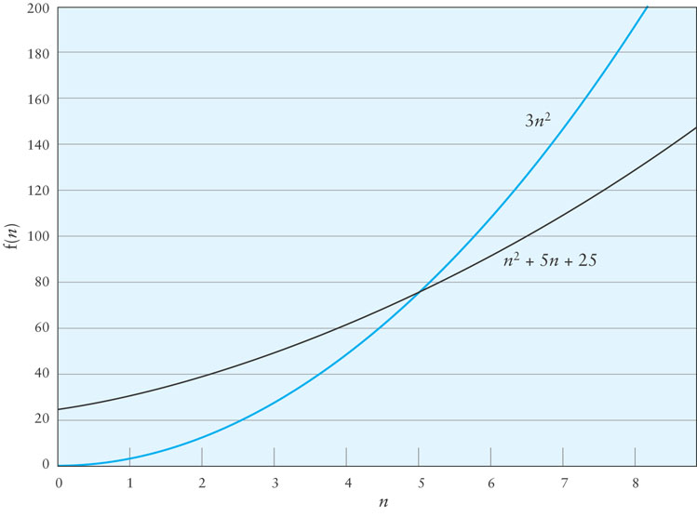
Formal Definition of Big-O
Notes:
Production Notes: Cheryl on scree and will point to graph
Here’s a graph. This shows that for n>5, 3n² is an upper bound for the function

Slide 13
12
Formal Definition of Big-O
f(n) = n² + 5n + 25 = O(n²)
Notes:
In general, you’re not going to have to provide a proof of the computational complexity of functions for this class.
But we have shown that there is an easy way to determine the computational complexity given the equation.
The growth rate of f(n) will be determined by the fastest growing term, which is the one with the largest exponent
Big O notation doesn’t include constants (i.e. no O(n/2)), and ignores lower terms

Slide 14
14
Big-O Example
Consider the following loop:
for (int i = 0; i < n; i++) {
for (int j = 0; j <= i; j++) {
1 simple statements
}
}
T(n) = 1 + 2 + … + n-1
T(n) = 1 + 2 + … + n – 1 = (n x (n-1))/2
Notes:
Cheryl Notes:
Therefore T(n) = 1.5n² – 1.5n
When n = 0, the polynomial has the value 0
For values of n > 1, 1.5n² > 1.5n² – 1.5n
Therefore T(n) is O(n²) when n₀ is 1 and c is 1.5

Slide 15
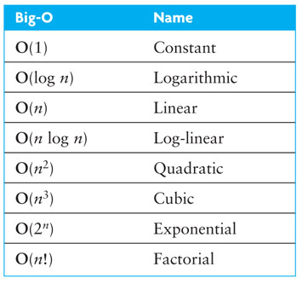
Common Growth Rates
Notes:
Here are some common growth rates and their names.
O(1) is also called “constant time”. It means it’s independent of the size of the problem.
In this class, we’ll be dealing with algorithms that are constant, logarithmic, linear, log-linear and quadratic.
Any function that is O(n^{i}) is called “polynomial”. We would always want to find an algorithm to solve a problem that is polynomial. As we will see in the next slide…

Slide 16
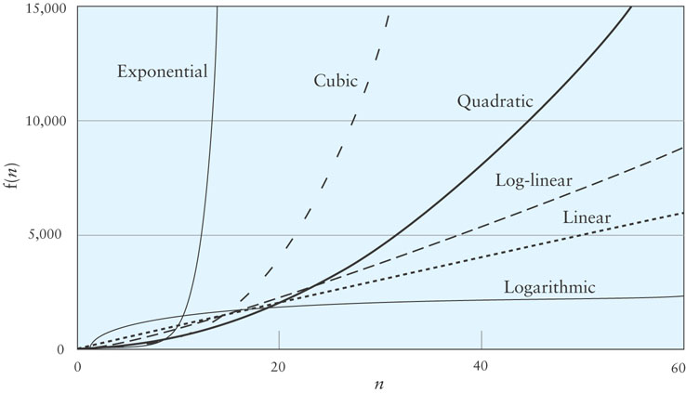
Different Growth Rates
http://bigocheatsheet.com/
Notes:
Production Notes: Cheryl on screen and will point to graphic.
Cheryl Notes:
Why do we care to go to the effort of finding a faster algorithm? We will study log-linear and quadratic sorting algorithms. The log-linear are harder to understand. Why bother? Because they’re significantly faster!
Once get out of polynomial time, performance costs are significant.
There are a class of algorithms called NP, which stands for non-deterministic polynomial time algorithms. A potential solution can be *checked* in polynomial time. P is a subset of these problems. NP-complete is another subset. These are problems that can’t be solved in polynomial time, any problem in the subset can be reduced to any other. Examples of NP-complete problems are the traveling salesman problem, where a traveling salesman has to visit a number of cities and return home, and do this in the smallest distance possible. Another example is the packing problem, where packages have to be fit in the smallest possible space. There is a million dollar prize for a polynomial time solution to any of the NP-complete problems.
Computational complexity is a fascinating computer science subject. If you’re interested, there are upper level classes in this subject.

Slide 17
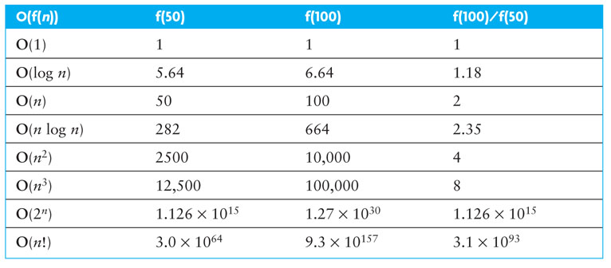
Effects of Different Growth Rates
Notes:
Production Notes: Cheryl on screen and will point to chart.
Cheryl Notes:
Algorithms with exponential and factorial growth rates have an effective practical limit on the size of the problem they can be used to solve
With an O(2^{n}) algorithm, if 100 inputs takes an hour then,
101 inputs will take 2 hours
105 inputs will take 32 hours
114 inputs will take 16,384 hours (almost 2 years!)
Encryption algorithms take advantage of this characteristic
Some cryptographic algorithms can be broken in O(2^{n}) time, where n is the number of bits in the key
A key length of 40 is considered breakable by a modern computer,
but a key length of 100 bits will take a billion-billion (10¹⁸) times longer than a key length of 40

Slide 18
2
Loops
int count = 0;
for (int i = 0; i<n; i++)
for (int j = 0; j<i; j++)
count++;

Slide 19
2
Loops
int count = 0;
for (int i = 0; i<n; i++)
for (int j = 0; j<10; j++)
count++;

Slide 20
2
Loops
int count = 0;
for (int i = 0; i<n; i++)
for (int j = 1; j<n; j=j*2)
count++;

Slide 21
2
Loops
int count = 0;
for (int i = 0; i<10; i++)
for (int j = 1; j<n; j=j*2)
count++;

Slide 22
4
An Example Algorithm – Brute Force
Find the largest subsequence sum
int maxSubSum(vector<int> & a) {
int maxSum = 0;
for (int i=0; i<a.size(); i++)
for (j=i; j<a.size(); j++)
{
int thisSum = 0;
for (int k = i; k <=j; k++)
thisSum += a[k];
if (thisSum > maxSum)
maxSum = thisSum;
}
return maxSum;
}

Slide 23
4
An Example Algorithm – Dynamic Programming (ish)
Find the largest subsequence sum
int maxSubSum(vector<int> & a) {
int maxSum = 0;
for (int i=0; i<a.size(); i++)
{ int thisSum = 0;
for (j=i; j<a.size(); j++)
{
thisSum += a[j];
if (thisSum > maxSum)
maxSum = thisSum;
}
}
return maxSum;
}

Slide 24
4
An Example Algorithm – A More Clever Algorithm
Find the largest subsequence sum
int maxSubSum(vector<int> & a) {
int maxSum = 0, thisSum = 0;
for (j=0; j<a.size(); j++)
{
thisSum += a[j];
if (thisSum > maxSum)
maxSum = thisSum;
else if (thisSum < 0)
thisSum = 0;
}
return maxSum;
}
If the beginning of the sequence is negative, it can’t be the start of a maximum subsequence
If adding 1 to the end of the subsequence makes the sum larger, then do it.
Unless part of the sequence goes below zero, it will be part of the maximum.

